Slide 1

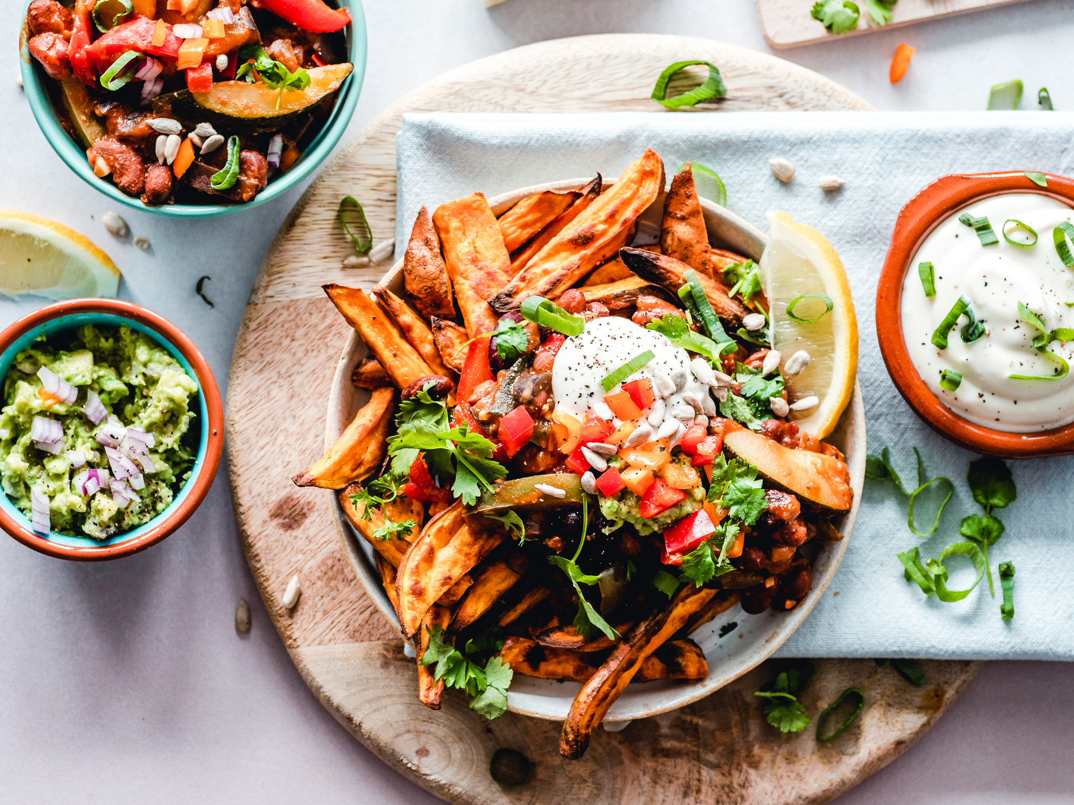
FAST
BITE
Presentation by
-K SUMA

Slide 2

AGENDA
Abstract
Introduction
Prerequisites Installations
Implementation process
Modules Included
Steps for the project
Output
Benefits
Conclusion

Slide 3
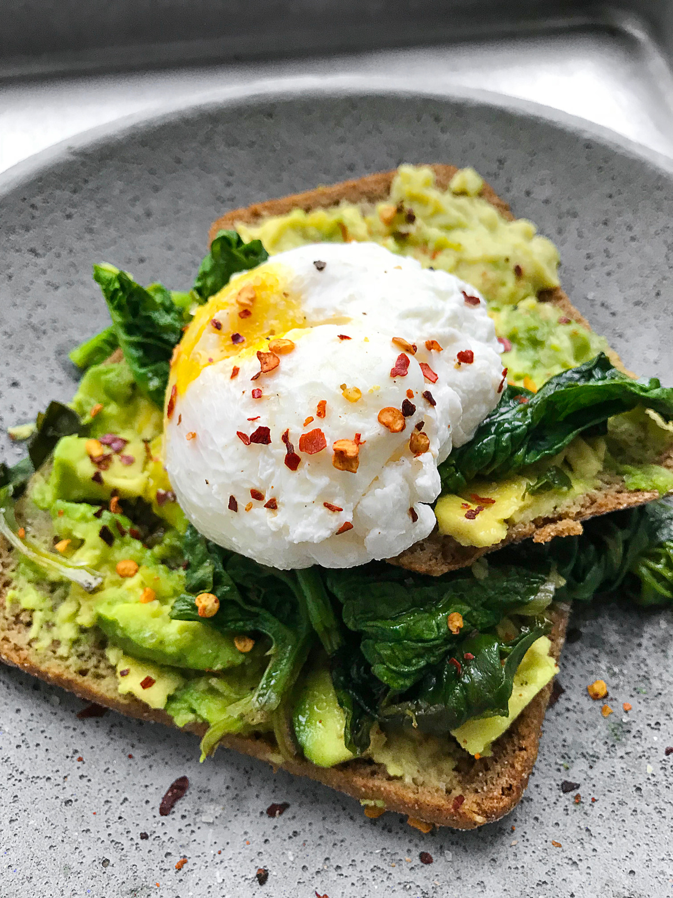
Abstract
The Online Food Ordering System developed using Django is a robust, web-based platform that simplifies the food delivery and takeout process. Built on Django, a high-level Python framework, the system efficiently manages user interactions, restaurant data, and order processing. Users can browse menus, customize orders, and make payments seamlessly. Django's ensures smooth database management, enabling the creation of models for users, restaurants, menu items, and orders.
The platform provides a secure user authentication system, allowing customers and restaurant staff to log in and access tailored functionalities. Restaurants can dynamically update their menus and track incoming orders through the Django admin interface. Real-time order status updates and payment integrations enhance the overall user experience. The system also employs Django templates to render dynamic content, ensuring a responsive and engaging interface.

Slide 4

Introduction
The Online Food Ordering System developed with Django is a comprehensive web platform that connects customers, restaurants, and delivery services, streamlining the entire food ordering process.
Restaurants can easily manage their profiles, update menus, and track incoming orders through an intuitive dashboard. The system provides real-time order management, enabling restaurants to process requests promptly and maintain customer satisfaction
For customers, the platform offers a seamless experience—from selecting their favorite meals to customizing orders and providing feedback. Secure authentication mechanisms protect user data, while integrated payment gateways ensure safe transactions.

Slide 5
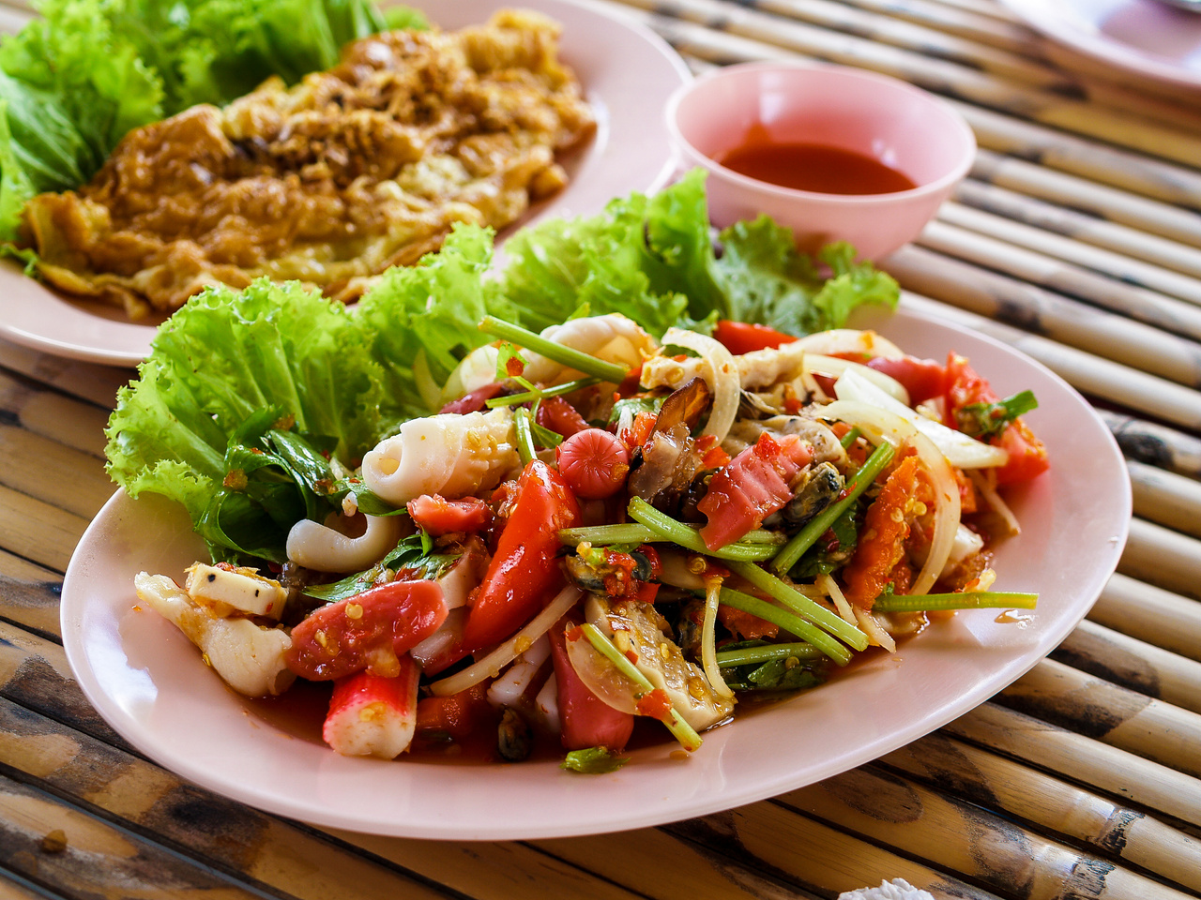
Prerequisites
Install these items in ur project---Open Vs Code
pip install django
pip install pillow
pip install django-crispy-forms
pip install crispy-bootstrap5 # For Bootstrap 5
pip install django-allauth
Django: The web framework.
Pillow: To handle image uploads (for menu items).
django-crispy-forms: For easy form styling using Bootstrap.
django-allauth: For user authentication (login, registration, and password management).
Bootstrap (optional): For styling your forms (Bootstrap 4 or 5).

Slide 6
Modules
THREE MODULES
Restaurant App: This will handle all the restaurant-related functionality, such as managing the menu items, viewing and processing orders, and managing food categories.
Customer App: This will handle everything related to customer interaction, such as viewing the menu, placing orders, tracking their orders, and user authentication.
Delivery App: This app will handle the delivery process, such as managing delivery agents, tracking order delivery status, and updating delivery details.
User Authentication (sign up, log in, log out)
Menu Management (adding, displaying, and managing food items)
Order Management (placing orders, calculating total price)

Slide 7
Steps For The Project
1. Create a New Django Project
Start by creating a new Django project:
cd path/to/your/directory
django-admin startproject food_ordering_system
cd food_ordering_system
2. Set Up a Virtual Environment
It’s a good practice to use a virtual environment to isolate project dependencies:
python -m venv .venv
3. Activate the Virtual Environment
On Windows:
.venv\Scripts\activate
Create a New Django Project
django-admin startproject food_ordering_system
cd food_ordering_system
*Create Three Django Apps: python manage.py startapp restaurant similarly deliver,customer
6. Run Migrations
Run migrations to set up the database schema:

Slide 8
6. Run Migrations
Run migrations to set up the database schema:
python manage.py makemigrations
python manage.py migrate
7. Configure settings.py
Set the EMAIL_BACKEND (use the console email backend for development):
EMAIL_BACKEND = 'django.core.mail.backends.console.EmailBackend' # For development
Set the login redirect URL:
LOGIN_REDIRECT_URL = '/' # Or wherever you want users to go after logging in
8. Configure URLs
In your urls.py, include the necessary routes for user authentication and your app's views.
In food_ordering_system/urls.py:
from django.db import models

Slide 9
15.Run the Development Server
After completing all configurations, you can run the Django development
python manage.py runserver
Now, you should be able to access the system at:
Restaurant-related pages: http://127.0.0.1:8000/restaurant/
Customer ordering pages: http://127.0.0.1:8000/customer/
Delivery assignment pages: http://127.0.0.1:8000/delivery/
Admin panel for managing content: http://127.0.0.1:8000/admin/

Slide 10
Benifits
1. Robust and Scalable Platform
2. Efficient Restaurant Management
3. Enhanced Customer Experience
4. Secure Transactions
5. Simplified Delivery Management

Slide 11
Conclusion
We have successfully set up a Django-based Online Food Ordering System with authentication, menu item management, and order management features. By following these steps, you've integrated important packages like django-allauth for user management, django-crispy-forms for form styling, and Pillow for image handling.

Slide 12
THANK YOU

